Slide 1

EXAM CENTER ALLOTMENT SYSTEM
Presented By:
M. Bindhu(46282529)
B.Sai sireesha (46287919)
Siraparapu rupika sri (46282334)
Anusha chalLapureddi (46282332)
Talabattula Sai SantHosHini ReethiIka
(46282334)

Slide 2
CONTENTS
Introduction
Abstract
About Project
Introduction
Requirements
Problem statement
Functional Specification
Technical Specification
Modules
Functional Requirement
Software Requirement
UseCase Diagram
Sequence Diagram
Tools
Conclusion

Slide 3
ABSTRACT
Exam Center Allotment System is an online process developed for colleges to simplify exam center allotment . It facilitates to access the examination information of a particular student . The purpose of developing Exam Center Allotment System is to computerized the traditional way of conducting exams.Another purpose for developing this software is to generate the candidate allotment report automatically during exams. Mostly students are facing many problems for finding the exam hall . A newly invented concept can aid for the students for checking their exam halls.
Admin have information about all the students who attend the examination. It contains the name of the student, ID of student, exam name, exam center details This project keeps track of various details in modules such as Candidate Details, Exam Details, and Exam center Details with the proper descriptions

Slide 4
ABOUT PROJECT
Exam center assignment is the process of allocating the candidate who are going to apply for any particular exam.
He/She will get exam center allocated based on the exam he/she applied.
The admin who is going to allot the exam center based on the exam, the admin will first checks before allocating the centers count and checks the availability and assigns the exam center.

Slide 5

INTRODUCTION
Exam Center Allotment System assigns exam center to candidates based on exam id and candidate id.
These information are stored in text files.
Exam center allocation is the process of allocating places for the candidate to write the exam.

Slide 6
Requirements
Problem Statement
Functional Specifications
Technical Specifications

Slide 7
PROBLEM STATEMENT
Exam Center Allotment System is an online process developed for colleges to simplify exam center allotment . It facilitates to access the examination information of a particular student
The purpose of this project is to allot exam centres based on the exam details provided by candidate.

Slide 8
FUNCTIONAL SPECIFICATION
Candidates appear for various exams. Exams are conducted in 3 exam centers. Application has to assign exam center based on which exam he/she is appearing for.
Information about exam centres based on exams is available in text file, this filename will be passed to application.
There are 3 exam centres with following information –
EX001|NEET|sp college|pune|1299|21/10/23
EX002|UPSC|jntuk|chennai|1098|13/2/23
EX003|MPSC|jntuh|mumbai|1200|15/3/23
Hallticket is generated with Candidate Id, Candidate name, Examcentre name, ExamcenterNo, ExamCenterId, Address and capacity.

Slide 9
TECHNICAL SPECIFICATIONS
Main menu:
Candidate
Exam Centre
Candidate: Candidate will provide his/her name and which exam he/she wants to appear.
Exam centre : Admin will generate the hall ticket and allot the exam centers according to the requirement.
After assigning is done admin will display total number of candidates and remaining capacity of exam center.

Slide 10
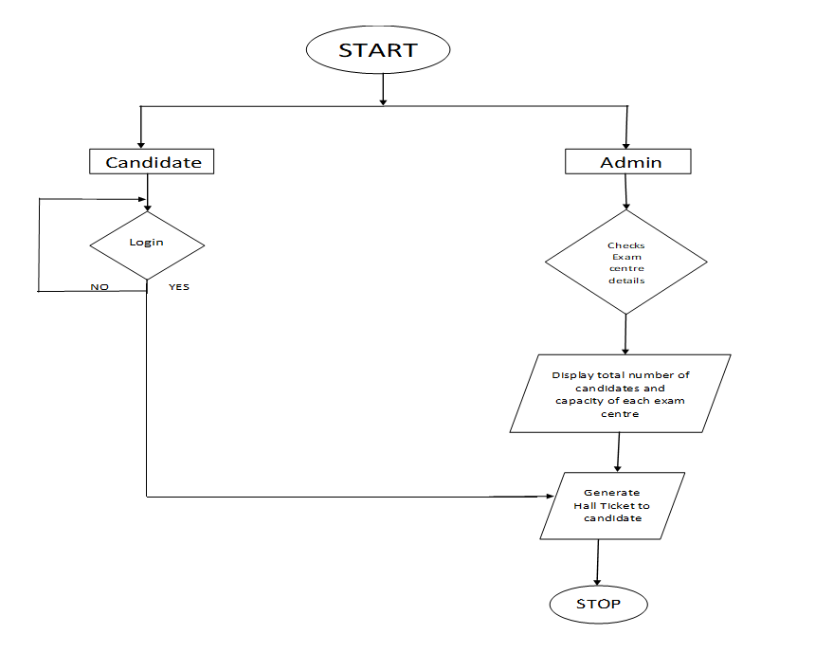
Flowchart:
ExamCenter Allotment System

Slide 11
MODULES
Candidate module:
Candidate will provide candidate name and exam he/she wanted to appear.
Exam centre module:
Admin will generate hall ticket which includes candidate ID and name, exam id , exam center no and name, address.
After assigning is done admin display total number of candidates and remaining capacity of exam center.

Slide 12
FUNCTIONAL REQUIREMENTS
int readCandidate()
int readExamCenter()
void updateCandidate()
void updateExamCenter()
void hallTicket_allotment()

Slide 13
SOFTWARE REQUIREMENTS
Linux
Ubuntu

Slide 14
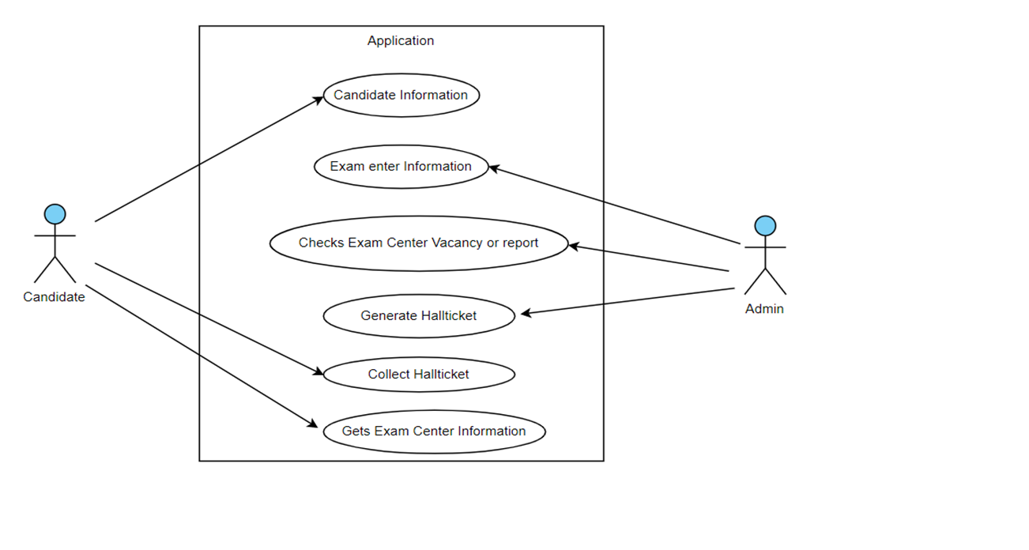
UseCase Diagram

Slide 15




Sequence Diagram

Slide 16
TOOLS
VALGRIND: It is memory checking tool to detect memory leaks and it majorly focus on dynamic memory.
SPLINT :Static analyzer which helps programmer in finding possible errors in program without having to compile or executing the program.
MAKEFILE: Tool used for run and compile program automatically in more efficient way.
IT testing:IT testing is used to test for enter code after the integration is done

Slide 17
Conclusion
In this project we have designed an application which allocates exam centers for respective exams.
Hall ticket is generated by admin.
We have used makefile to built this application.

Slide 18
Thank you

